Slide 1
DDD: Digitizing Information for Disease Detection
Heak Hok
Digital Divide Data (DDD)

Slide 2
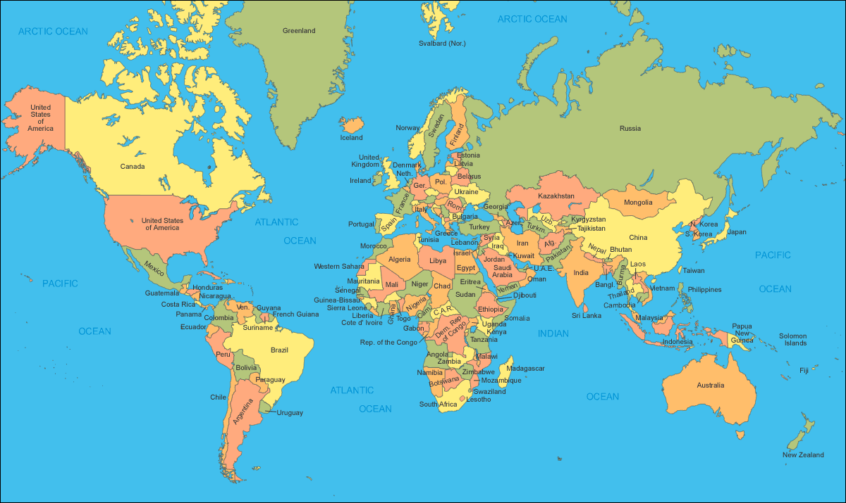
^{About DDD}
DDD locations
Phnom Penh, Cambodia
Vientiane, Laos
Nairobi, Kenya

Slide 3
^{The Cycle of} ^{Poverty}
3.
1.
2.

Slide 4
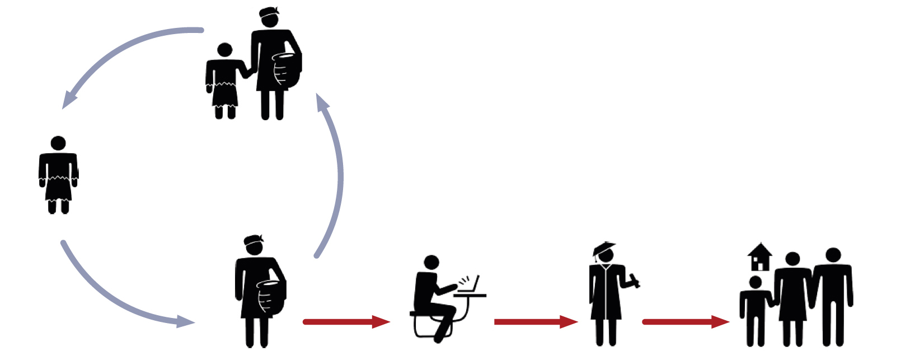
^{Breaking the Cycle of Poverty}

Slide 5
^{DDD’s Work/Study Program}
1. Recruitment
2. Training
3. Employment
4. Graduation

Slide 6
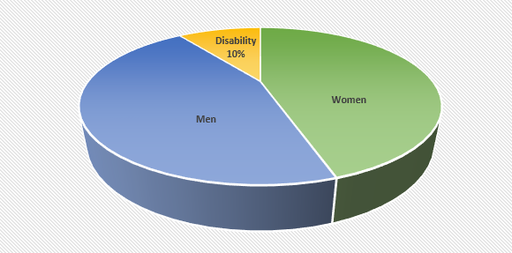
^{Our Staff}

Slide 7
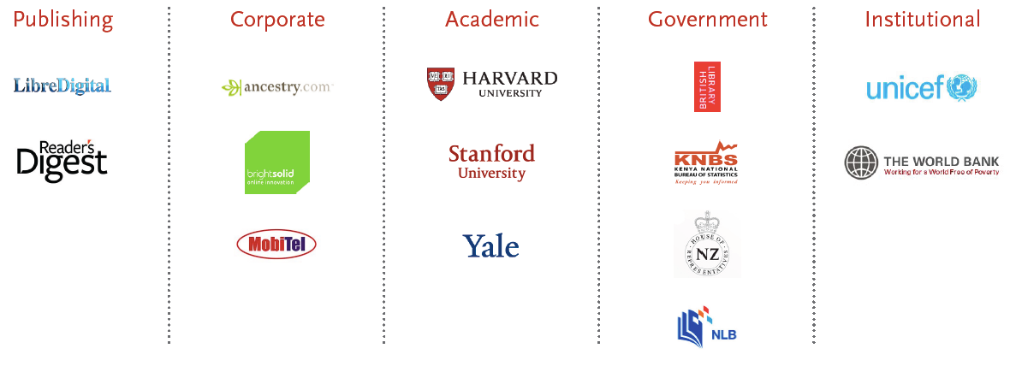
Our Clients

Slide 8
Delivering Value To Business Clients

Slide 9
Grace under Pressure

Slide 10
Digital Disease Detection
Newspaper

Slide 11
Digital Disease Detection (cont.)
Health Surveys
Hands washing
Causes of Anemia in Children

Slide 12
Digital Disease Detection (cont.)
Local Newspapers

Slide 13
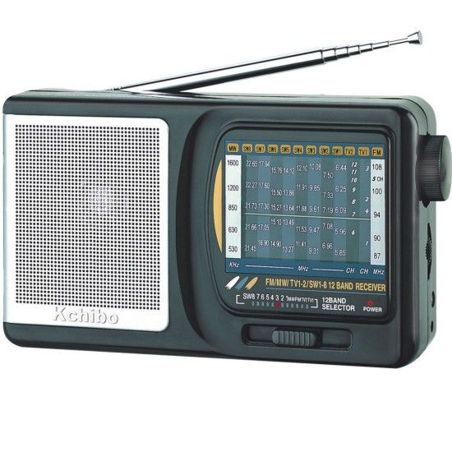
Digital Disease Detection (cont.)
Local Radios/TVs

Slide 14
Thank you

